Slide 1



Curriculum Mapping
Summer 2020 Workshop: Content Series #2
presented by: Dr. Summer DeProw
July 8, 2020
AState.edu
/ArkansasState
@ArkansasState

Slide 2



Workshop Procedures
Welcome and thank you for participating in our Summer Workshop Series!
You will be muted upon entry to the workshop, so please introduce yourself via the Chat feature by clicking “Chat.”
The window to the right will appear where you can add your introduction:
If you have questions during the session, please add them to the Chat box and at the conclusion of our time we will include them in the Q and A.
AState.edu
/ArkansasState
@ArkansasState

Slide 3
Workshop Agenda
Attendees will be able to:
Align Required and Elective Courses to applicable PLOs
Excel Worksheet
Mapping scheme that works best for your program:
“Touches” vs. Assessed, Contributes, Introduce/Reinforced/Mastered
Including “Mapping” in Syllabi
Creating PDFs for Syllabi Appendices
AState.edu
/ArkansasState
@ArkansasState

Slide 4
Curriculum Map: What is it?
A curriculum map/audit is a tool used to record curriculum-related inter-connections that identifies program-level student learning outcomes, the courses in which the content is taught, and level at which the content is taught. This map could include other elements, but for the purpose of this workshop, it will only include the aforementioned items.
AState.edu
/ArkansasState
@ArkansasState

Slide 5
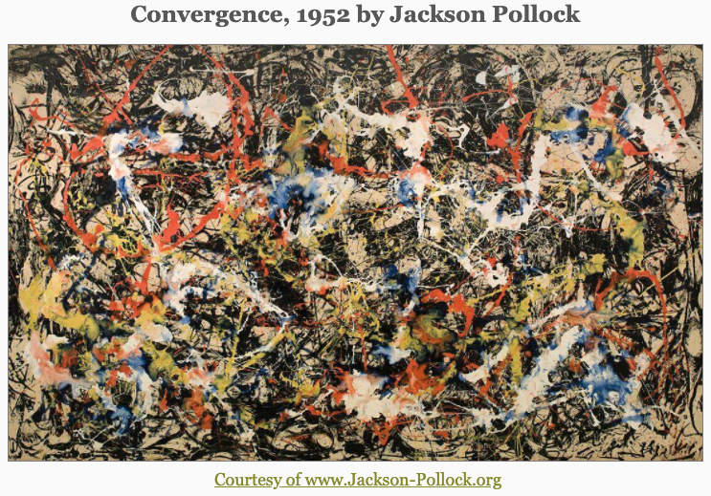
Articulate program structure?
AState.edu
/ArkansasState
@ArkansasState

Slide 6
Curriculum Map: Who needs it?
Every academic program on campus should complete a curriculum map.
Faculty need it to determine where the courses they teach fit into the overall program in which they teach and which outcomes their courses are accountable for helping to achieve.
Students could use it to better understand the purpose and the placement of the courses they are taking in a program and how they fit into the overall program they are pursuing.
AState.edu
/ArkansasState
@ArkansasState

Slide 7
Curriculum Map: What are its functions?
Useful for detecting holes in curriculum
Useful for pinpointing exactly where to address opportunities for improvement
Useful for determining faculty teaching assignments
Useful for determining where, when, and how to assess program-level student learning outcomes
AState.edu
/ArkansasState
@ArkansasState

Slide 8
Curriculum Map: Common Questions from Faculty
Who did this curriculum map? Why are my courses on it?
If you/we mark “my” class, am I required to asses the course?
If you/we mark “my” class, am I required to report data from the course to the Assessment Office?
AState.edu
/ArkansasState
@ArkansasState

Slide 9
Curriculum Map: How to create it
No need! We did it for you using excel!
We listed all the courses in the program in the first column; then we listed all the program-level student learning outcomes in a row across the top of the spreadsheet.
Next, we placed the letters I (introduce), E (emphasize), and/or R (reinforce) in the rows beside each course to represent in which course an outcome is introduced, emphasized, and/or reinforced. Confused yet? Good; let us show you!
AState.edu
/ArkansasState
@ArkansasState

Slide 10
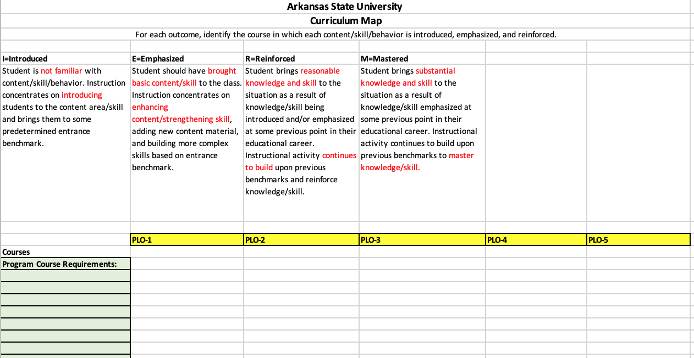
Building a Curriculum Map
Use Excel template to begin construction
Choose levels that are most applicable to your program
Add Program Learning Outcomes in Columns across top
Add Program Courses in Rows down left
AState.edu
/ArkansasState
@ArkansasState

Slide 11
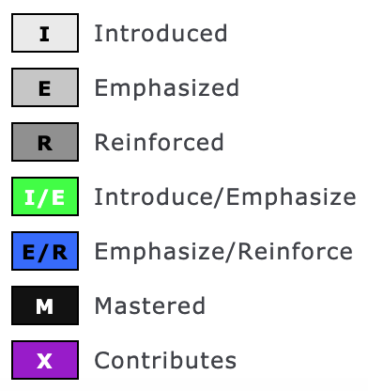
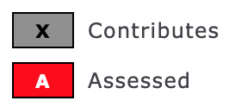
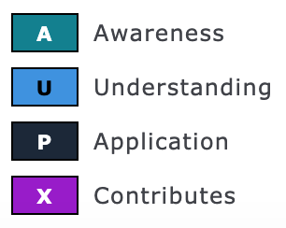
Mapping Schemes
Use Excel template to begin construction
Choose levels that are most applicable to your program
Add Program Learning Outcomes in Columns across top
Add Program Courses in Rows down left
Current Curriculum Mapping Level Schemes in use at A-State:
Traditional Levels:
Undergrad Engineering:
Media and Communication:
AState.edu
/ArkansasState
@ArkansasState

Slide 12
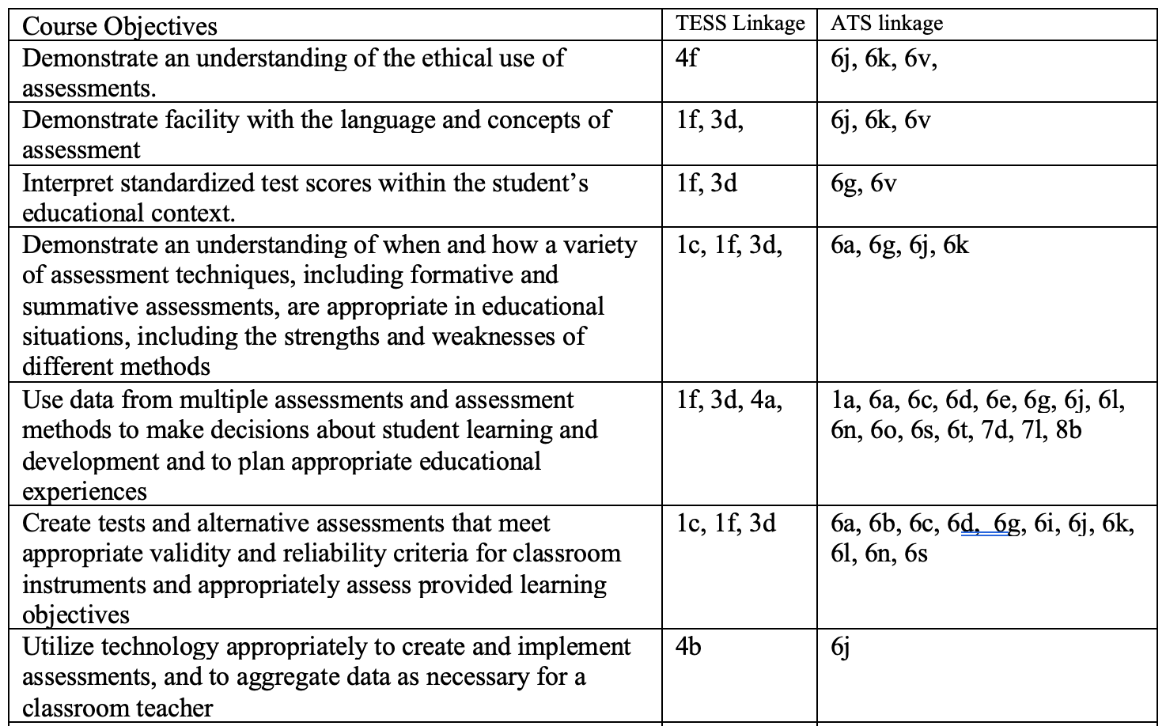
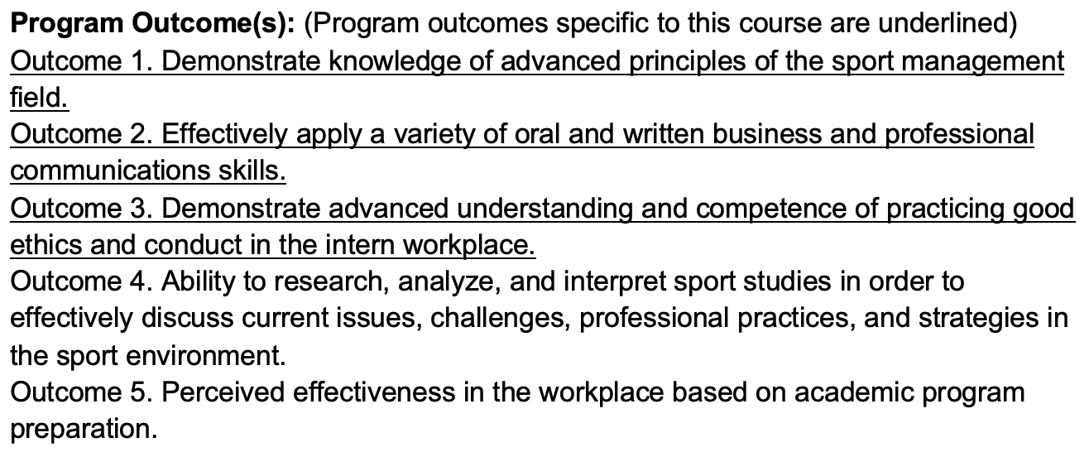
Examples of Curriculum Map Communication in Syllabi
There are numerous ways to communicate mapping of program and course curriculum in a syllabus.
One example is to create a PDF version of a map built in Taskstream, add the map as an appendices in the syllabi and state that a course’s alignment can be found in the map.
Below are two more examples of curriculum mapping communication. The chart on the left is mapping for a course to prescribed program standards, while the mapping on the right is for outcomes written by A-State program faculty.
Syllabi examples courtesy of Dr. Joanna Grymes, Associate Professor and Dr. Claudia Benavides Ambs, Associate Professor
AState.edu
/ArkansasState
@ArkansasState

Slide 13
Review/Audits of Curriculum Maps
Problems encountered
Things to consider
AState.edu
/ArkansasState
@ArkansasState

Slide 14

Session Q & A
AState.edu
/ArkansasState
@ArkansasState

Slide 15
Best Practices for Curriculum Mapping
Build in practice and multiple learning trials for students: introduce, reinforce, master. Students will perform best if they are introduced to the learning outcome early in the curriculum and then given sufficient practice and reinforcement before evaluation of their level of mastery takes place.
Use the curriculum map to identify the learning opportunities (e.g., assignments, activities) that produce the program’s outcomes.
Allow faculty members to teach to their strengths (note: each person need not cover all outcomes in a single course). “Hand off” particular outcomes to those best suited for the task.
Ask if the department/program is trying to do too much. Eliminate outcomes that are not highly-valued and then focus on highly-valued outcomes by including them in multiple courses. (The eliminated outcomes can still be course-level outcomes. They need not disappear completely from the curriculum.)
Set priorities as a department/program. Everyone working together toward common outcomes can increase the likelihood that students will meet or exceed expectations.
Communicate: Publish the curriculum map and distribute to students and faculty.
Communicate: Each faculty member can make explicit connections across courses for the students. For example, at the beginning of the course or unit, a faculty member can remind students what they were introduced to in another course and explain how the current course will have them practice or expand their knowledge. Do not expect students to be able to make those connections by themselves.
AState.edu
/ArkansasState
@ArkansasState
https://manoa.hawaii.edu/assessment/resources/curriculum-mapping-curriculum-matrix/#four

Slide 16
References
Curriculum Mapping / Curriculum Matrix. (n.d.). Retrieved July 02, 2020, from https://manoa.hawaii.edu/assessment/resources/curriculum-mapping-curriculum-matrix/
Jacobs, H. H. (2010). Curriculum 21: Essential education for a changing world. Alexandria, VA: Association for Supervision and Curriculum Development.
AState.edu
/ArkansasState
@ArkansasState

